Slide 1
Stress Management Transforming Life Challenges Through Awareness and Action
Presented by Jeff Stellmach, LCSW
Employee Assistance Program (EAP)
512-471-3366
Jeff.stellmach@austin.utexas.edu
http://www.utexas.edu/hr/eap/

Slide 2
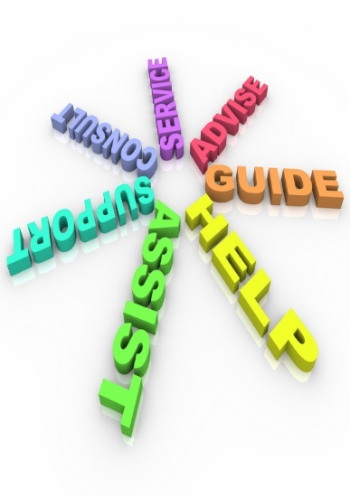
HealthPoint Employee Assistance Program (EAP)
EAP is a resource for all benefits-eligible employees, adult dependents, partners, and retirees.
Confidential, short-term counseling
Community referrals
Manager consultation and training
Trainings and groups on a variety of topics
Workplace safety and crisis management
Stress Reduction and Biofeedback Center
In-person or virtual counseling via Zoom, Teams, or phone

Slide 3
EAP offers in-person and telecounseling
Virtual sessions conducted by phone, Zoom, or Teams
Office located at UTA, 1616 Guadalupe
Schedule by phone or email

Slide 4
Campus stress management resources
EAP Mindful Meditation Groups on Zoom – Tuesdays at 5:00 PM and Thursdays at 12:00 PM noon, register for initial sessions on UTLearn: https://utlearn.utexas.edu/
CMHC Drop-in Meditation Group - Tuesdays at 11:45 AM on Zoom: https://cmhc.utexas.edu/groups.html
The University Yoga Club (check their Facebook page for dates and times)
EAP Stress Reduction webpage for relaxation tracks and further instructional materials
http://sites.utexas.edu/srbc/stress-reduction-biofeedback-center/

Slide 5
Strategies for dealing with stress
Understanding and awareness
Body posture
Meditation and mindfulness
Self-care
Physically discharging stress
Notes:
Read the points first
Before next slide----QUESTION ----“How do you know that you’re stressed?”

Slide 6
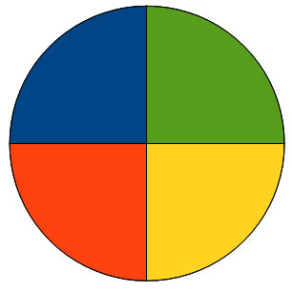
Signs that you’re stressed
Four domains
Physical
Emotional
Behavioral
Social

Slide 7
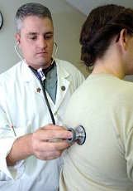
Physical signs of stress
Headaches
Sore neck or shoulders
Muscle tension
Changes in sleep patterns
Digestive problems
Reduced libido
Fatigue
Notes:
The protection, tucking in response

Slide 8
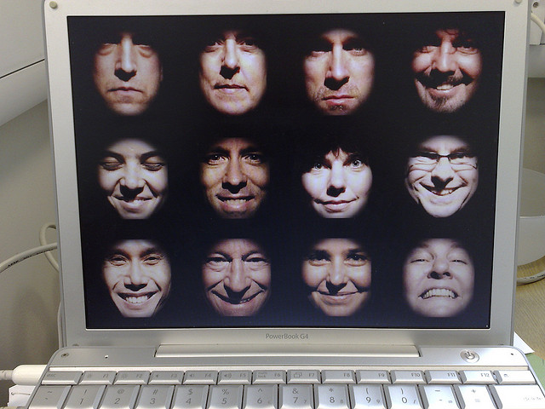
Emotional signs of stress
Sad
Mad
Scared
Anxious
Depressed
Irritable

Slide 9
Behavioral signs of stress
Forgetfulness
Irritability
Poor concentration
Distractibility
Negative attitude
Reduced motivation/productivity
Boredom

Slide 10
Social signs of stress
Loneliness
Reduced social contact
Social anxiety
Lack of intimacy

Slide 11
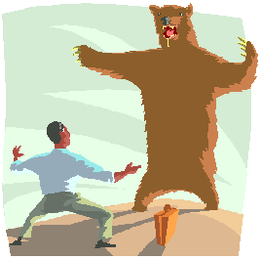
The physical experience of stress
Our physical response to stress can often be acute, a type of fight or flight reaction. What is this?
We respond to stressors by increasing heart rate and breathing, directing blood to the limbs and muscles, and scanning the environment for possible threats.
We are designed to rapidly respond to stress and challenge, often called the stress response. This response is adaptive when the challenge is immediate and requires immediate action.

Slide 12
The prolonged stress response
We are not physically designed to stay in an acute stress response.
When fight or flight remains activated, we tend to view all things through the lens of a threat.
If we maintain a hyper-focus on a perceived threat, we lose the ability to see other coping options.

Slide 13
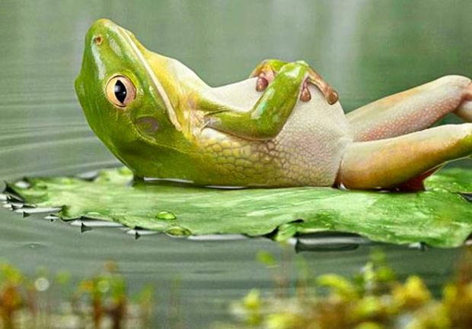
Slowing down: The relaxation response
Physically relieving stress through relaxation is often the most attainable goal.
Even if the goal is to address a problem, physically reducing stress makes us better able to see options and cope effectively.
Achieving the relaxation response renews our ability to enjoy the moment.
Notes:
Mention passive/aggressive/assertive and how this relates to fight or flight principles

Slide 14
Proper seated posture
Feet flat on the floor
Legs bent at 90 degree angle
Hands resting in lap or thighs
Back straight
Use back of chair only as
much as you need to
If you’re accustomed to leaning into back of chair, work towards better posture incrementally so you don’t hurt yourself

Slide 15
Meditation exercise
Try to place yourself in good posture and breathe in a rhythm that’s comfortable for you. Slowly increase the duration of both your inhale and your exhale.
Now try to maintain your thinking in an open, in-the-moment stance. When your thoughts attach to something, simply return your attention to your deep, relaxed breathing.
If you experience intrusive thoughts, observe them without judgment and allow them to pass. A self-statement like, “I notice myself thinking” may be helpful. Return your attention to your breath.
If you are having rapid thoughts, adjust the level of your gaze downward without changing the level of your head. If you are becoming tired, shift the level of your gaze upward.

Slide 16
Questions for you
Did you close your eyes while meditating?
What were you aware of in terms of your thinking?
How did you respond when intrusive thoughts entered?

Slide 17
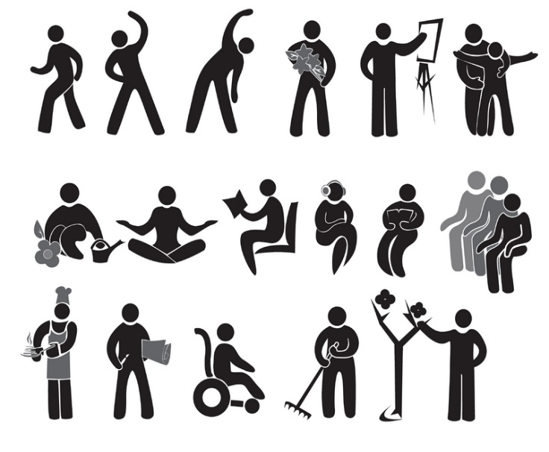
Mindful activities to re-set our rhythms
These are activities that bring you into the moment and have a calming effect.
They are typically simple, requiring a basic focus and present awareness.
They work to regulate our breathing and reduce baseline anxiety.
An effective technique can be to observe your breathing during or after a mindful activity to capture and mark the rhythms of our relaxed breathing state. This breathing awareness can be as short as 20 – 30 seconds.

Slide 18
Some mindful activities
Swimming, walking, biking, hiking
Craft work
Cooking
Yoga
Gardening
Fishing
Reading
Listening to or playing music
Barbecuing
And more . . .

Slide 19
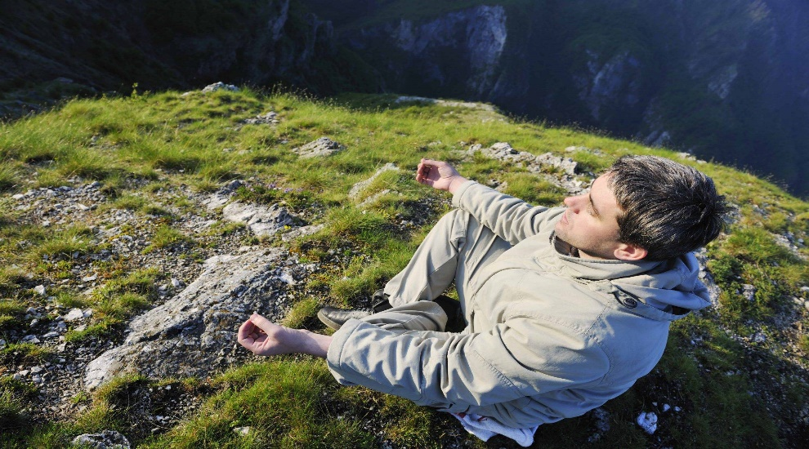
More on mindful activities
Write down the mindful activities you already do.
Write down the mindful activities you would like to learn or try to do more consistently.

Slide 20
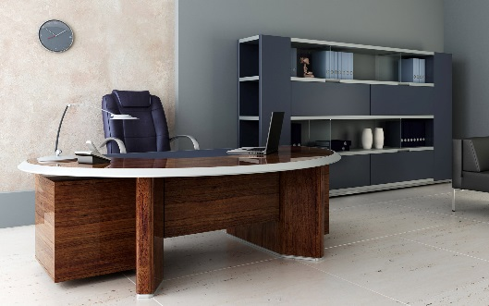
Mindful activities during your workday
Write down the mindful activities you already do during your workday.
How could you modify an activity you do in your personal time and make it work at the job?

Slide 21
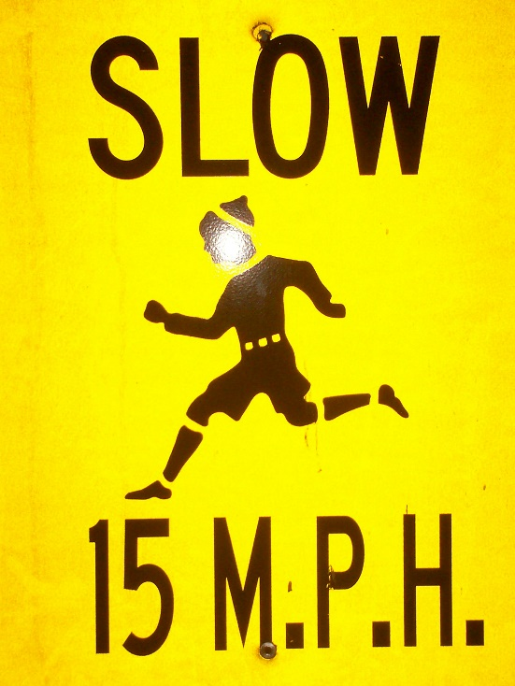
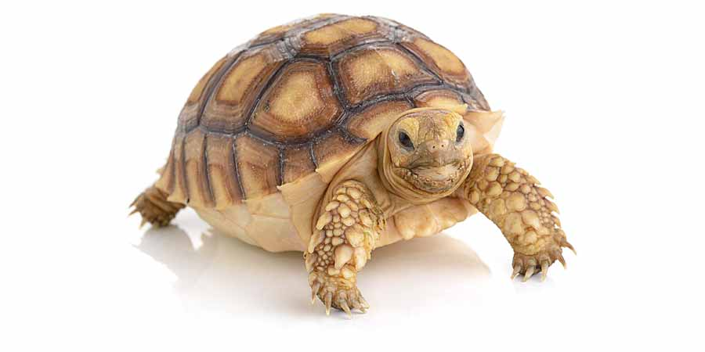
Slowing down
Most any basic activity
we do can be even more
mindful by doing it slower
than we otherwise would.

Slide 22
What is self-care?
Self-care involves intentional actions we take to care for our physical, mental, and emotional health.
It can be thought of as a type of maintenance condition that is needed to cope best with stress.
Healthy self-care positively impacts our baseline level of anxiety.

Slide 23
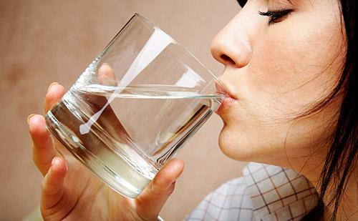
Self-care actions
Get quality sleep, between 7-10 hours for most people
Eat a healthy diet with meals throughout the day
Be sure to stay hydrated throughout the day
Get 15 minutes of sun or fresh air every day
Get in some physical activity every day
Take some time to stretch tense muscles
Breathe deeply at times you feel yourself anxious or hurried

Slide 24
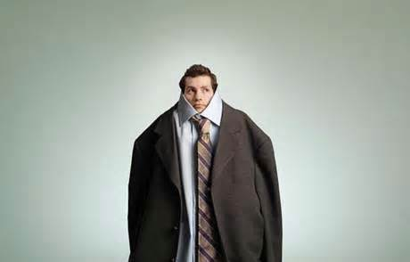
Fitting self-care into your day
Sleep
Diet
Water
Time outside
Physical activity
Stretching
Breathing
Of the self-care actions listed, write the ones you feel are well established habits in your life.
Write the habits you would like to improve.
Of the actions you would like to increase, what is a realistic goal for you?

Slide 25
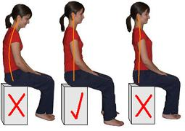
Do a posture check
As an exercise to get physical feel of healthy posture, start in a slumped position with your eyes looking down at the floor (figure at the far left). Hold this position for 5-10 seconds.
Pull your shoulders back and up until you feel they are in alignment with your lower back. Also bring your head to a level where you are looking straight in front of you (figure in the middle). Hold this position for 5-10 seconds.
Now arch your lower back in an exaggerated manner so that you feel slight tightness in lower back. Also pull your shoulders back until you feel slight tightness across your chest (figure on far right). Hold this position for 5-10 seconds.
Return your body to the good posture position and hold this for 15 seconds.

Slide 26
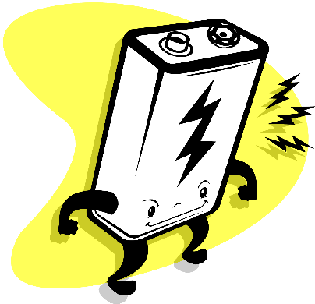
The physical discharge of stress
When fight or flight is activated, we have been given a physical energy to engage a stressor.
Quite often we are unable to direct physical energy at our current challenge.
Being able to physically discharge the energy we’ve generated, even when directed towards something unrelated, helps our body return to homeostasis.

Slide 27
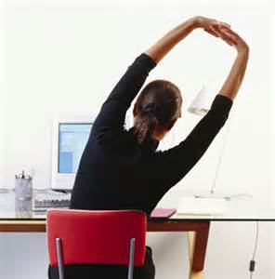
Discharging stress: When, where, and how
Write down how you discharge stress in your personal life, away from work.
Write how you discharge stress during the workday.
Are there discharge activities you do during your personal time that you could adapt to your workplace?

Slide 28
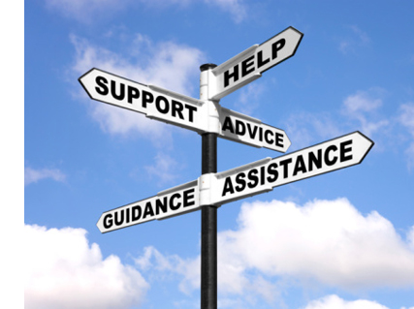
Your on-campus stress management resource
The counselors at EAP are skilled in working with individuals towards improved coping with stress. We invite you to schedule a time with us to speak about your unique life challenges and the ways you can best respond with awareness and action.

